Slide 1
The M-Factor
Round 2: Case Study
Candidate name: Do Nguyen Ngoc Minh

Slide 2
Part 1

Slide 3
Part 1
Part 1.1
Total Revenue in January : 1409827.02…………………….
Data : [Link Google Sheet]
Part 1.2
Total New Users in January : 28…………………….
Data : [Link Google Sheet]

Slide 4
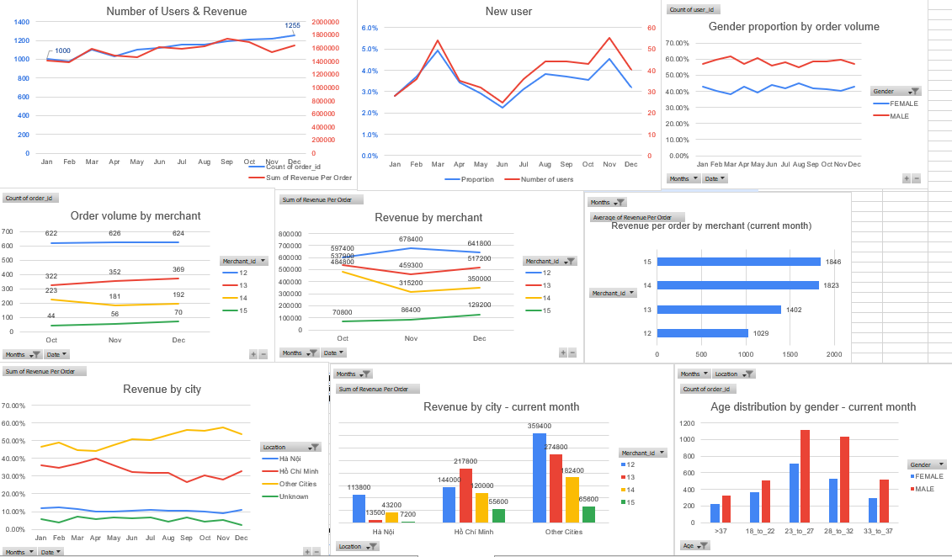
Part 1 – Performance Dashboard

Slide 5
Part 2

Slide 6
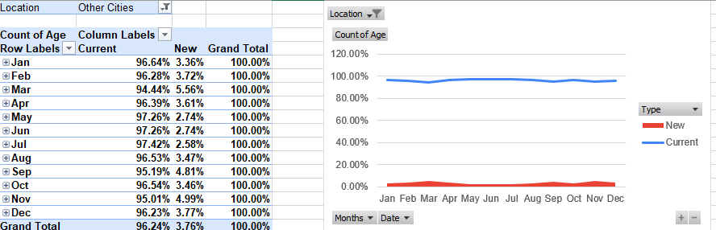
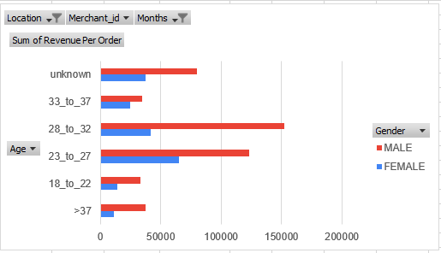
Part 2.1 – Promotion campaign
From performance dashboard, we observe the increase in the number of top up revenue in other cities. Let’s focus on this branch.
We see a steadiness proportion in current and new user in top up from other cities. Which means every user type is evenly increasing.
With most of the income are generated from Male from 23 to 32 years old.

Slide 7
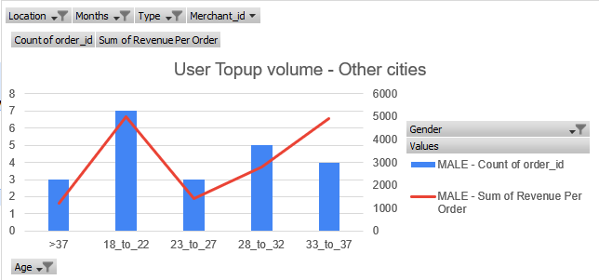
Part 2.1 – Promotion campaign
However, in the last three months, new users from 33 to 37 years old are promising.
Though they have moderate number of orders, the revenue generated is as high as that from 18-22 year-old users, who are newly use our top up the most.
We can focus our MKT campaign on 33 to 37 years old users from other cities after considering our budget, as new users are decreasing in the overall number. TVC is promising but costly, KOL/influencers could be suitable.

Slide 8
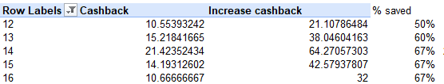
Part 2.2 - Cashback
A worth-try option
From current user perspective: This is worth continue to use
One user can feel like they have gained more than a half compared to their last transaction (which was not applied the increased cashback)
From our business: Still a good choice
New users is decreasing in proportion >> Converting current users to regular users is crucial
With the same pace, our revenue lost is just 1.5% of the cashback before increase scheme:
Value of an order is decreasing in the last 2months (referred to performance dashboard) >> If we increase amount of cashback, our cashback overall value could remain low in the future while number of users is increasing.
However, the unevenly rate in the cashback might not be a good choice in this case as current users does not seem to decrease in merchant id 14.15.16. Our revenue lost might be wasted.

Slide 9
Part 3

Slide 10
Part 3.1 – Topup development strategy
Extended services
Recharge phone
“Recharge your phone on time – you wont miss any opportunities”
Find the frequency of recharge phone from each regular user and offer them their last recharge amount from the same merchant at the right time.
Auto top-up, scheduled top up
Users are allowed to set top-up preferences once and the top-up will recur automatically according to the set criteria.
Users can also set a time for a top-up to occur

Slide 11
Part 3.2
The size of largest relationship circles : 11
The number of largest relationship circles : 1
Algorithm Explanation : [Google Sheet/ Google Colab Link (if any)]

